Slide 1
Git and GitHub

Slide 2
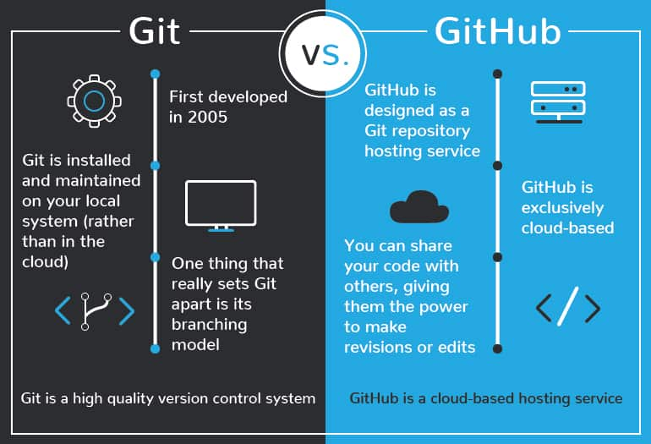
What is Git?
Git is used to store the source code for a project and track the complete history of all changes to that code. It allows developers to collaborate on a project more effectively by providing tools for managing possibly conflicting changes from multiple developers.

Slide 3
Git Installation:→
Git Install
You can download Git for free from the following website: https://www.git-scm.com/
Using Git with Command Line
To start using Git, we are first going to open up our Command shell.
For Windows, you can use Git bash, which comes included in Git for Windows. For Mac and Linux you can use the built-in terminal.
The first thing we need to do, is to check if Git is properly installed:
Example
git –version
git version 2.30.2.windows.1
If Git is installed, it should show something like git version X.Y

Slide 4
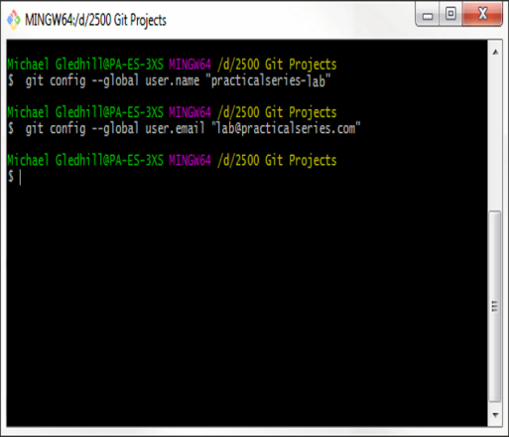
Configure Git
git config --global user.name "Hitesh“
git config --global user.email “hjha03144@gmail.com”
Creating Git Folder
Now, let's create a new folder for our project:
Example
mkdir myproject
cd myproject
mkdir makes a new directory.
cd changes the current working directory.
Now that we are in the correct directory. We can start by initializing Git!

Slide 5
Git Help Command
If you are having trouble remembering commands or options for commands, you can use Git help.
There are a couple of different ways you can use the help command in command line:
git command -help
- See all the available options for the specific command
git help –all
- See all possible commands
Let's go over the different commands.

Slide 6
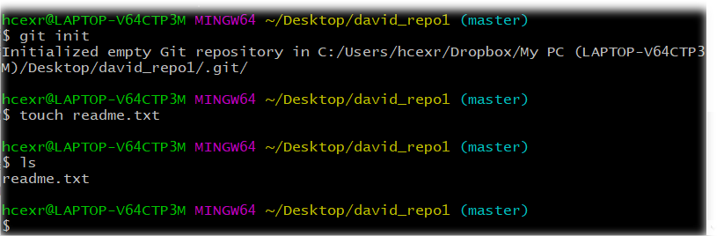
Initialize Git
Once you have navigated to the correct folder, you can initialize Git on that folder:
Example
git init
Initialized empty Git repository in /Users/user/myproject/.git/ You just created your first Git Repository!

Slide 7
Git Adding New Files
You just created your first local Git repo. But it is empty.
Fort this folder I’m creating simple any coding file using any text editor
Using System
Using namespace std
{
Class Git{
Public static void Main(string[]args)
{
Console.WriteLine(“This is the first file in my Git repo”);
}
}
}

Slide 8
List and Status Commands
And save it to our new folder as Git.cs
Example
ls
Git.cs
ls will list the files in the directory. We can see that Git.cs is there.
Then we check the Git status and see if it is a part of our repo:
Example
git status
On branch master
No commits yetUntracked files:
(use "git add ..." to include in what will be committed)
Git.csnothing added to commit but untracked files present (use "git add" to track)
Now Git is aware of the file, but has not added it to our repository!
Files in your Git repository folder can be in one of 2 states:
Tracked
Untracked –
When you first add files to an empty repository, they are all untracked. To get Git to track them, you need to stage them, or add them to the staging environment.

Slide 9
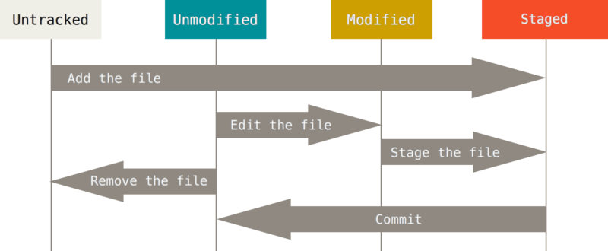
Git Staging Environment
One of the core functions of Git is the concepts of the Staging Environment, and the Commit.
As you are working, you may be adding, editing and removing files. But whenever you hit a milestone or finish a part of the work, you should add the files to a Staging Environment.
Staged files are files that are ready to be committed to the repository you are working on. You will learn more about commit shortly.
For now, we are done working with Git.cs. So we can add it to the Staging Environment:
Example
git add Git.cs
The file should be Staged. Let's check the status::
Example
git status
On branch master
No commits
yetChanges to be committed:
(use "git rm --cached ..." to unstage)
new file: Git.cs

Slide 10

Git Add More than One File
You can also stage more than one file at a time. Let's add 2 more files to our working folder. Use the text editor again.
A README.md file that describes the repository (recommended for all repositories):
This repository is built step by step in the tutorial.
Using System
Using namespace std
{
Class Git
{
Public static void Main(string[]args)
{
Console.WriteLine(“This is the first file in my Git repo”); Console.WriteLine(“I’ve added one more file or else I should say I will updated in my file”);
}
}
}
Example
git add –all
Using --all instead of individual filenames will stage all changes (new, modified, and deleted) files
Example
git status

Slide 11
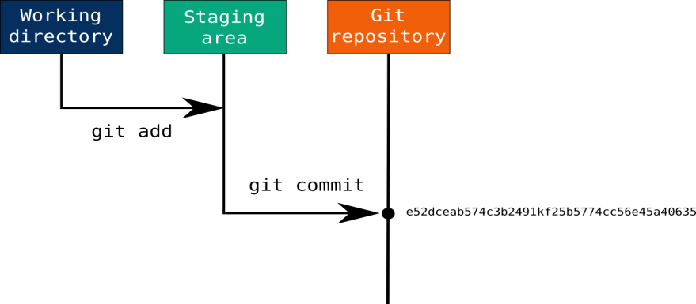
Git Commit
Since we have finished our work, we are ready move from stage to commit for our repo.
When we commit, we should always include a message.
Example
git commit -m "First release of Hello World!“
[master (root-commit) 221ec6e]
First release of Hello World!
The commit command performs a commit,
and the -m "message" adds a message.

Slide 12

What is GitHub?
GitHub is a web-based version-control and collaboration platform for software developers.
Microsoft, the biggest single contributor to GitHub.
Git is not the same as GitHub.
GitHub makes tools that use Git.
Three important terms used by developers in GitHub are fork, pull request and merge

Slide 13


GitHub Page
GitHub makes tools that use Git.
GitHub is the largest host of source code in the world, and has been owned by Microsoft since 2018.

Slide 14
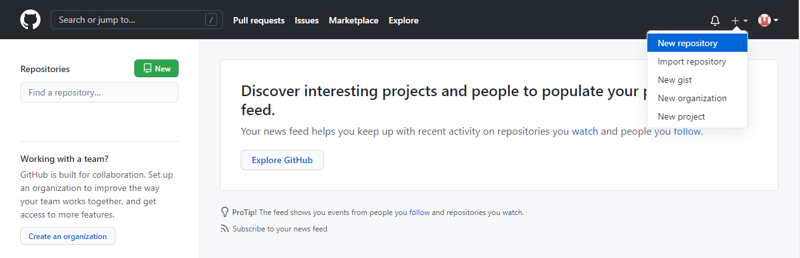
Create a Repository on GitHub
Now that you have made a GitHub account, sign in, and create a new Repo:
After Creating Repository you will see interface like this shown below :-

Slide 15
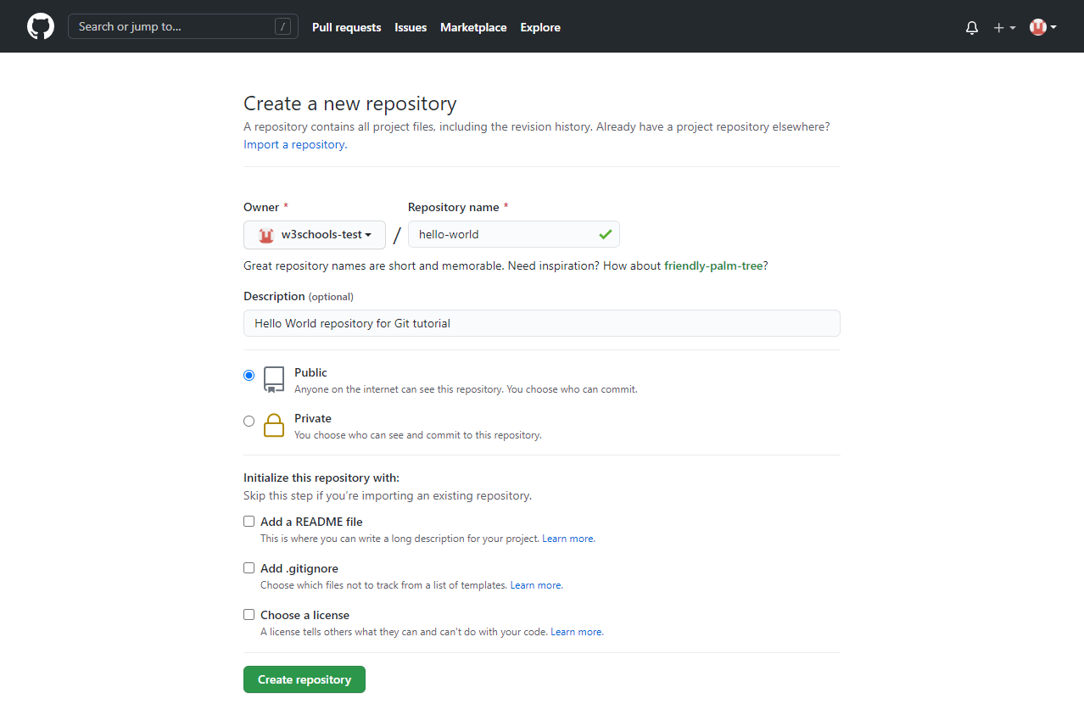
Filling the details in Repo
After Creating the repository fill all the relevant details like name of the repository and making it as public or private then adding the Readme file for documentation

Slide 16
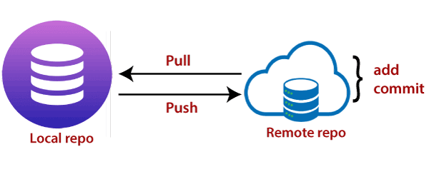
Push Local Repository to GitHub
Since we have already set up a local Git repo, we are going to push that to GitHub:
Copy the URL, or click the clipboard marked in the image above.
Now paste it the following command:
Example
git remote add origin https://github.com/Dark2003fire/hello-world.git
git remote add origin URL
specifies that you are adding a remote repository, with the specified URL, as an origin to your local Git repo.
Now we are going to push our master branch to the origin url, and set it as the default remote branch:
git push --set-upstream origin master
Since this is the first time you are connecting to GitHub, you will get some kind of notification you to authenticate this connection.
Now, go back into GitHub and see that the repository has been updated:

Slide 17
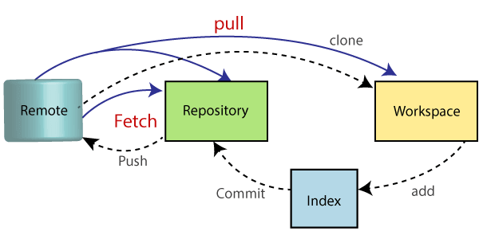
Pulling to the Repo
When working as a team on a project, it is important that everyone stays up to date.
Any time you start working on a project, you should get the most recent changes to your local copy.
With Git, you can do that with pull.
pull is a combination of 2 different commands:
fetch
merge
Let's take a closer look into how fetch, merge, and pull works.
Git Fetch
fetch gets all the change history of a tracked branch/repo.
So, on your local Git, fetch updates to see what has changed on GitHub:

Slide 18
Log and Diff
git fetch origin
Now that we have the recent changes, we can check our status:
Example
git status
On branch master
Your branch is behind 'origin/master' by 1 commit, and can be fast-forwarded. (use "git pull" to update your local branch) nothing to commit, working tree clean
git log origin/master
That looks as expected, but we can also verify by showing the differences between our local master and origin/master:
Example
git diff origin/master
That looks precisely as expected! Now we can safely merge.

Slide 19
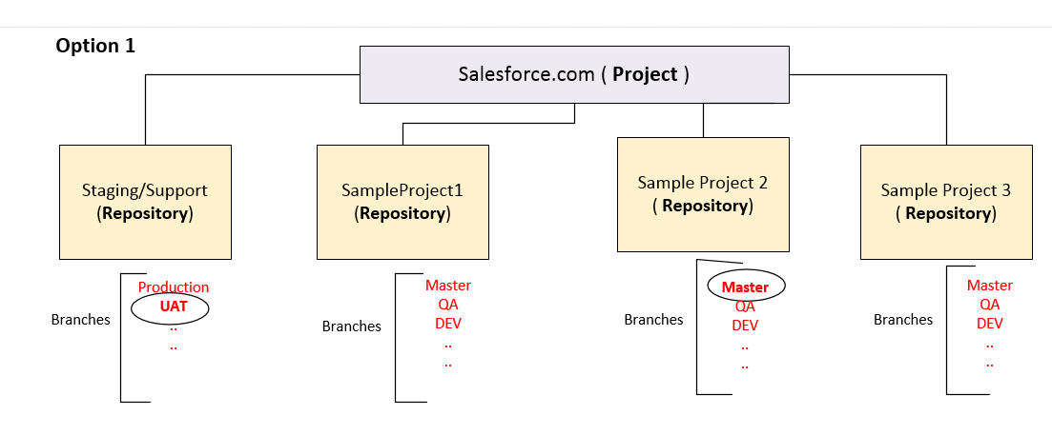
Git Merge
merge combines the current branch, with a specified branch.
We have confirmed that the updates are as expected, and we can merge our current branch (master) with origin/master:
git merge origin/master
Check our status again to confirm we are up to date:
Example
git status

Slide 20
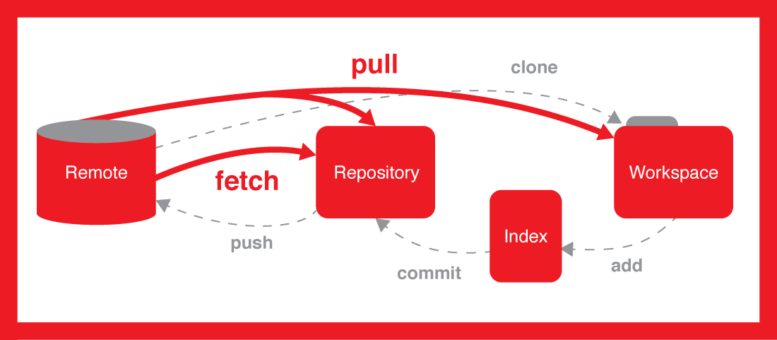
Git Pull
But what if you just want to update your local repository, without going through all those steps?
pull is a combination of fetch and merge. It is used to pull all changes from a remote repository into the branch you are working on.Use pull to update our local Git:
git pull origin

Slide 21
Git Push to GitHub
Let's try making some changes to our local git and pushing them to GitHub.
Example
git commit -a -m "Updated Git.cs
Resized image"
And check the status:
Example
git status
On branch masterY
our branch is ahead of 'origin/master' by 1 commit.
(use "git push" to publish your local commits)
nothing to commit, working tree clean
git push origin
Go to GitHub, and confirm that the repository has a new commit:

Slide 22
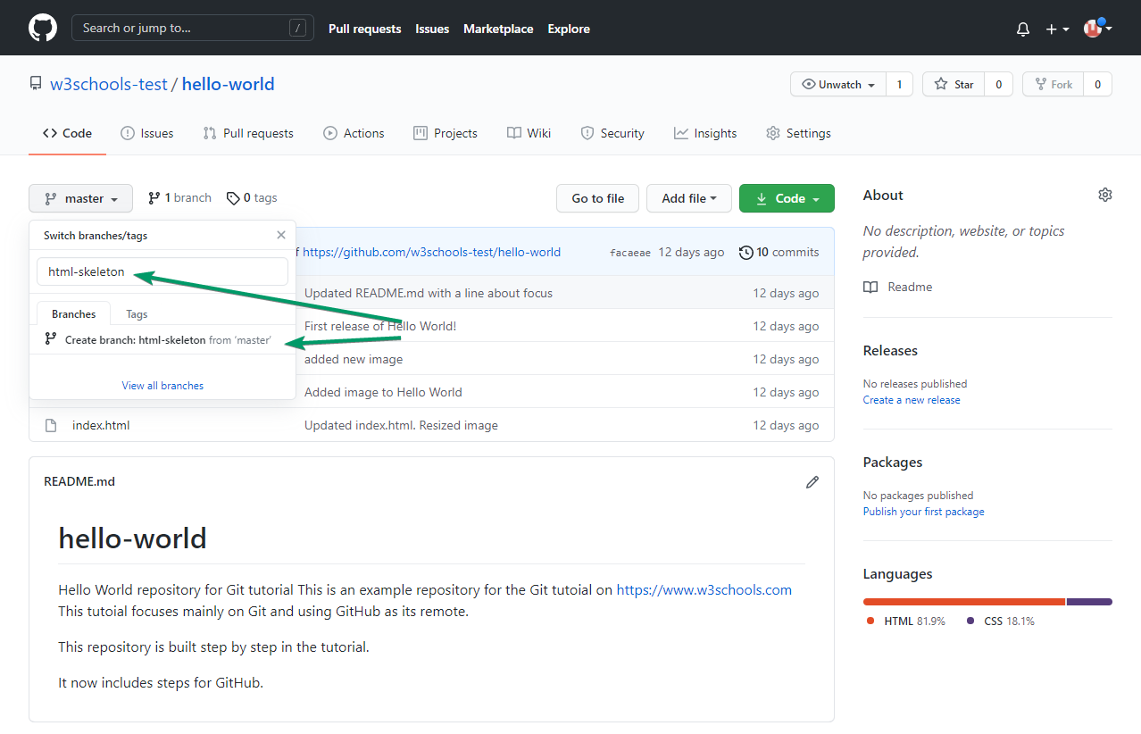
Create a New Branch for Master
On GitHub, access your repository and click the "master" branch button.
There you can create a new Branch. Type in a descriptive name, and click Create branch:

Slide 23
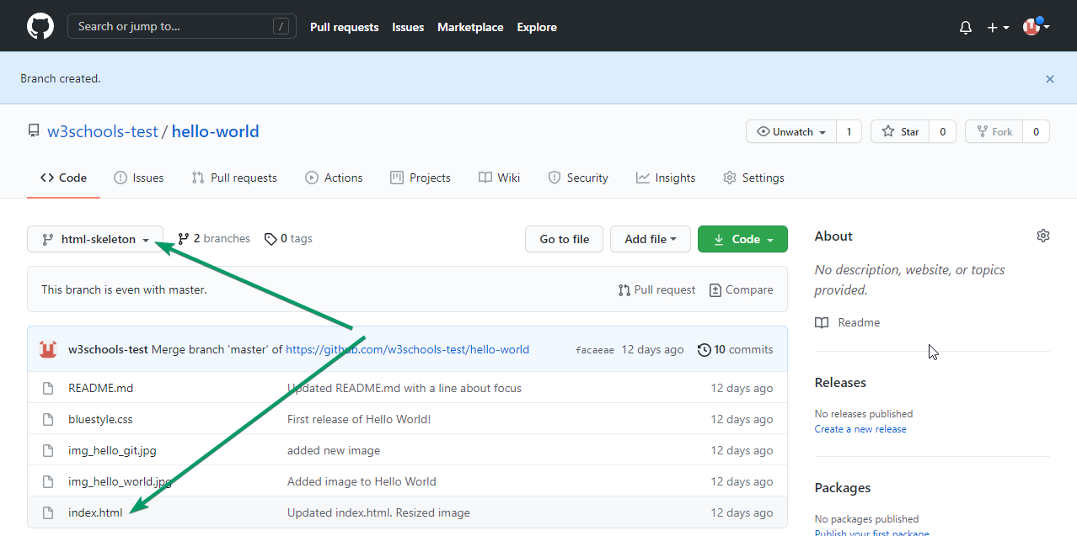
Selecting a Branch
Selecting a created branch from the github and working with that as hown below

Slide 24
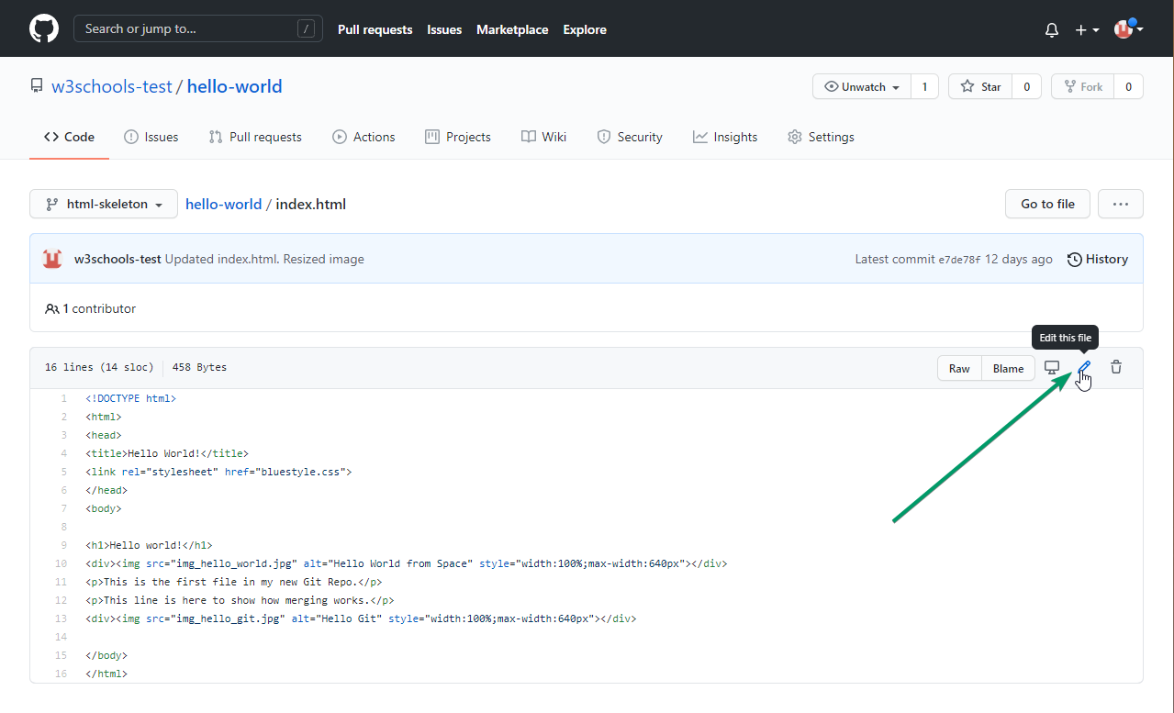
Editing the existing file
We can do modifications and updation in the existing repository and then we can do the changes we require it is shown below

Slide 25
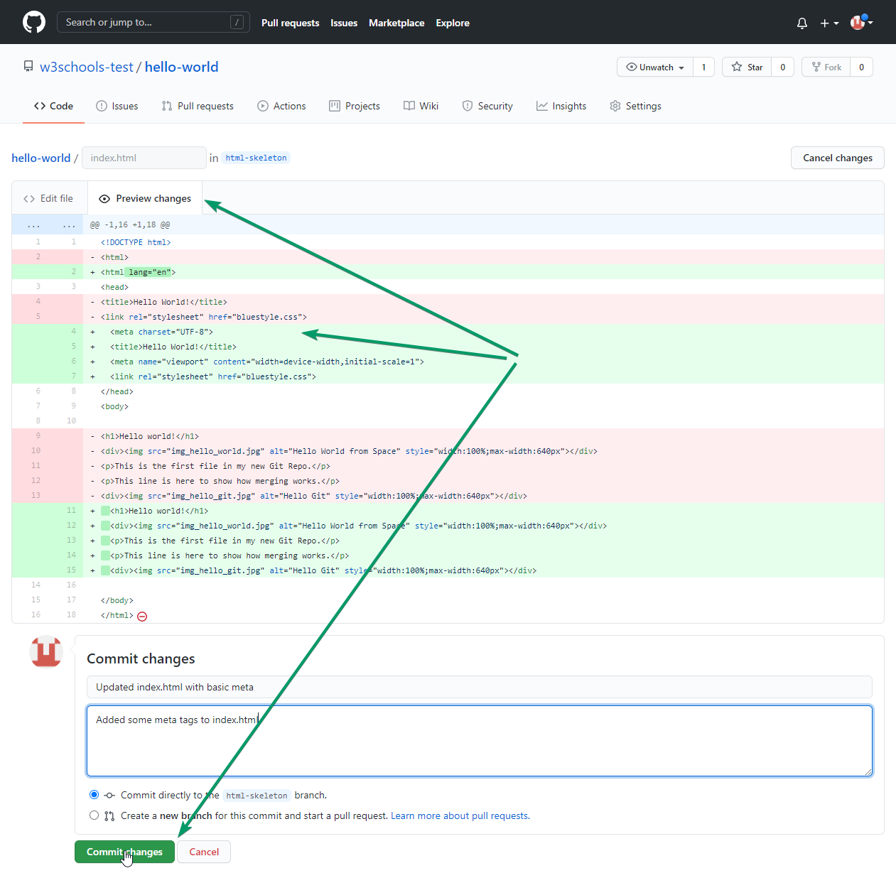
Commiting Changes
After doing modifications and updating the file we are ready to commit the changes

Slide 26
# git Commands to add the whole project into GitHub
Steps :--->
1) git init
2) git Status
3) git add .
4) git commit -m "Initial Commit"
5) git status (if anything is Present then again use (Git add .) command)
6) git remote add origin here u will add that repository SSH link copy from there and paste it here
7) git push origin master
8) git status

